Slide 1
Ms. Wist’s Room
Room 242 Math
Please find a seat. We will have a seating chart by the end of the week, so don’t get too attached to your seat.

Slide 2
Welcome!
“If you are not willing to learn, no one can help you. If you are determined to learn, no one can stop you.”

Slide 3






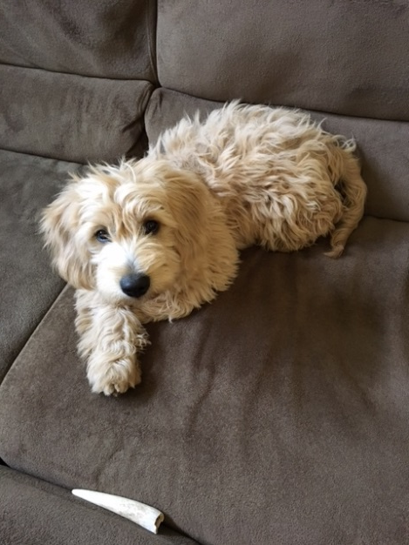

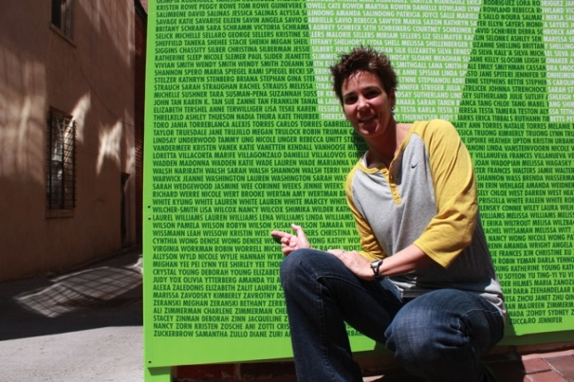

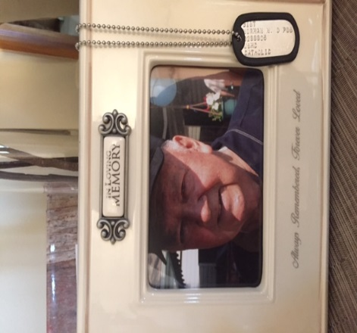

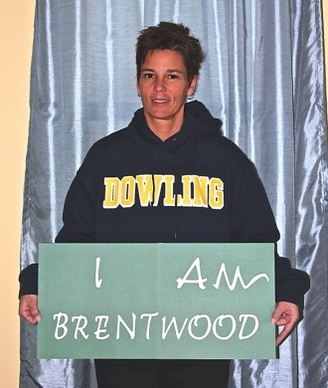

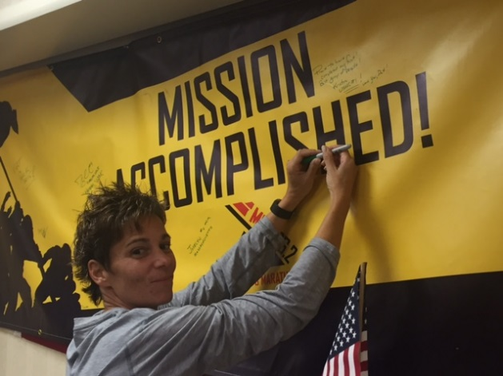
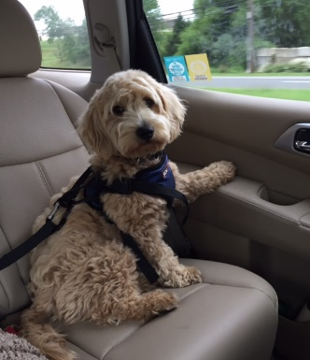


A little about me…

Slide 4
Classroom Procedures
Ms. Wist
East Middle School

Slide 5
Coming into class…
Be on time.
Enter the classroom quietly.
Go directly to your assigned seat.
Begin working on your Do Now.

Slide 6
During class…
Listen and pay attention at all times.
Raise your hand to ask a question or to sharpen your pencil if it should break.
If I am writing notes, you’d better be too. ☺
All Do Nows, notes, homework assignments, tests, quizzes, etc. should be done in pencil. Pens are frowned upon in math class.
Participate.

Slide 7
Assignments…
You will be expected to do work each day in class.
All assignments are posted on my website, mswist.weebly.com and most notes/worksheets can be printed.
Always put your first and last name, the date, and your class period on each assignment if you are asked to submit it.
Homework assignments will consistently reinforce important concepts learned throughout the year.

Slide 8
Before leaving class…
You will be dismissed by me, not the bell.
If we use calculators, we will not leave class until all my calculators are on the returned to the proper pockets.
Pick up around your table. Do not leave garbage on your desk or on the floor.
If you borrow something from me, please be respectful and return it.

Slide 9
If you are tardy…
Tardiness is not acceptable.
One unexcused tardy per quarter will result in a warning.
Any tardy after the that will result in after school detention.

Slide 10
If you are absent…
You are responsible for any missed work. Any notes/assignments can be found in the crate in the back of the room. I will not remind you if you missed an assignment.
If you miss a test or a quiz, you will need to schedule a time to stay with me and make it up.
It is your responsibility to make up work after you’re absent. I will not track you down.

Slide 11
Classroom Rules…
Be respectful.
Be patient.
Be on task.
Be prepared.
Be on time.

Slide 12
Consequences…
In this class, I expect you follow my classroom expectations. If you fail to do so, the following steps will occur:
Verbal warning
Student conference
Detention/parent contact
Referral to administration
Severe interruption: sent to the office immediately.

Slide 13
Substitute procedures…
If I should be absent from school, I expect you to give the substitute complete respect.
All rules and procedures should be followed every day regardless of who is at the front of the room.
If your name is left by a substitute for any negative reason, you will receive a referral, a detention with me after school, and I will call home.
The number one rule in this class is to be respectful. This does not change when I’m not here.

Slide 14
How will you be graded?
Grading Policy
Tests 40%
Quizzes 20%
Homework 25%
Participation 15%

Slide 15
Website…
http://mswist.weebly.com

Slide 16
Remember…
If you are not willing to learn, no one can help you. If you are determined to learn, no one can stop you.
I know that we are going to have an amazing year! Work hard every day and I promise it will pay off!

